Slide 1
Propositional Logic

Slide 2
Logic in AI
Serves two purposes:
A representation language for knowledge.
A theory of reasoning.
There are many logics. We will look at two, the most important;
Propositional logic aka propositional calculus or Boolean logic
Predicate calculus aka first-order logic.

Slide 3
Logic, in general
A logic consists of three parts:
A syntax, which specifies what is a validly formed sentence.
A semantics, which specifies what a sentence means.
A theory of inference, which specifies when one sentence is a consequence of other sentences.
Theory = set of sentences.

Slide 4
Logic
Theory written in the logic
Logical symbol --- defined by the logic.
Non-logical symbol --- defined by the theorist
Syntax – What arrangement of symbols is a sentence?
Semantics – What does a sentence mean?
Inference
Programming language
Program written in the PL
Reserved symbol --- defined by the PL.
Identifier – defined by the programmer.
Syntax – What arrangement of symbols is a program?
Semantics – What does a program do?

Slide 5
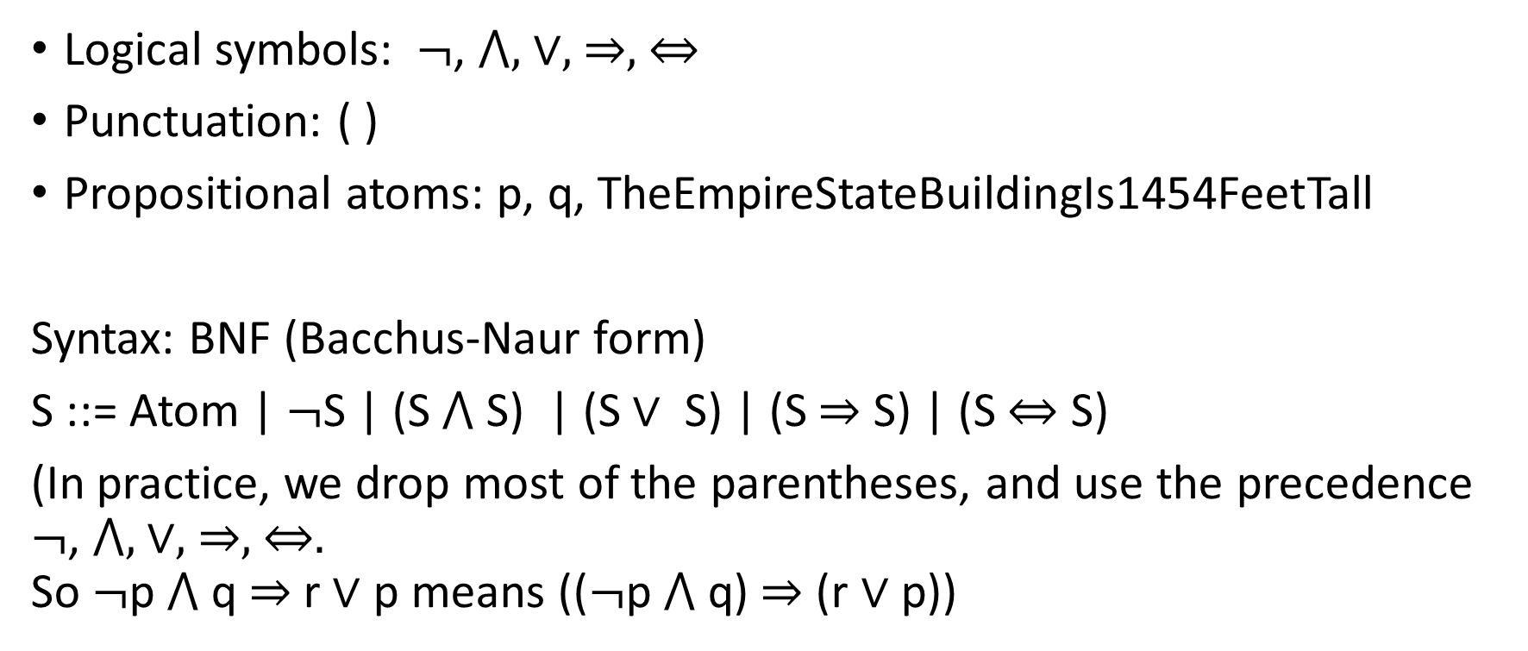
Propositional logic
Logical symbols: $¬$, ⋀, ∨, ⇒, ⇔
Punctuation: ( )
Propositional atoms: p, q, TheEmpireStateBuildingIs1454FeetTall
Syntax: BNF (Bacchus-Naur form)
S ::= Atom | $¬$S | (S ⋀ S) | (S ∨ S) | (S ⇒ S) | (S ⇔ S)
(In practice, we drop most of the parentheses, and use the precedence $¬$, ⋀, ∨, ⇒, ⇔. So $¬$p ⋀ q ⇒ r ∨ p means (($¬$p ⋀ q) ⇒ (r ∨ p))

Slide 6

So the syntax of a sentence is a tree
(($¬$p ⋀ q) ⇒ (r ∨ s))
S
S S
S
S S S S
(($¬$p ⋀ q) ⇒ (r ∨ p))

Slide 7
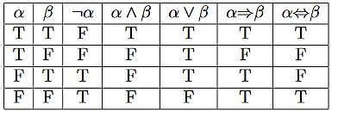
Semantics
The “meaning” of a sentence in the propositional calculus is its truth value: true or false.
A valuation on the atoms is an assignment of each atom to be true or false.
The semantics of the prop. calc.: Given a valuation on the atoms, determine whether a sentence is true or false.
Work bottom up in the syntax tree, using the truth table for the operator at each step.

Slide 8

Truth conditional semantics
Valuation: p=T, q=F, r=F
S:T
S:F S:T
S:F
S:T S:F S :F S:T
(($¬$p ⋀ q) ⇒ (r ∨ p))
T F F T

Slide 9
Note on “p⇒q” (material implication)
In the logics we will look at, “p⇒q” means that either p is false or q is true.
That’s all it means.
It does not mean that you can derive q from p.
It does not mean that p causes q.
It does not mean that p is true first and then q is true.

Slide 10
Note on “p⇒q” (material implication)
“If pigs cannot fly, then Albany is the capital of New York State” is true (T ⇒T)
“If pigs can fly, then Albany is the capital of New York State” is true (F ⇒T)
“If pigs can fly, then New York City is the capital of New York State” is true (F ⇒F)
“If pigs cannot fly, then New York City is the capital of New York State” is false (T ⇒F)

Slide 11


Slide 12
Davis-Putnam-Logemann-Loveland (DPLL) algorithm (1962)
Martin Davis (no relation. Mathematician and computer scientist. Taught at NYU. Retired, alive and well in Berkeley)
Hilary Putnam (Philosopher and logician at Harvard)
George Logemann and Donald Loveland (logicians)
DPLL algorithm:
Input: A set of sentences in propositional logic.
Output: Either a valuation on the atoms that makes all of the sentences true or “Fail” if no such valuation exists.

Slide 13
Very high-level algorithm
Convert sentences to conjunctive normal form (CNF)
Run DPLL algorithm.
So obviously there are three questions to answer
What is CNF?
How do you convert sentences in prop. logic to CNF?
What is the DPLL algorithm?

Slide 14
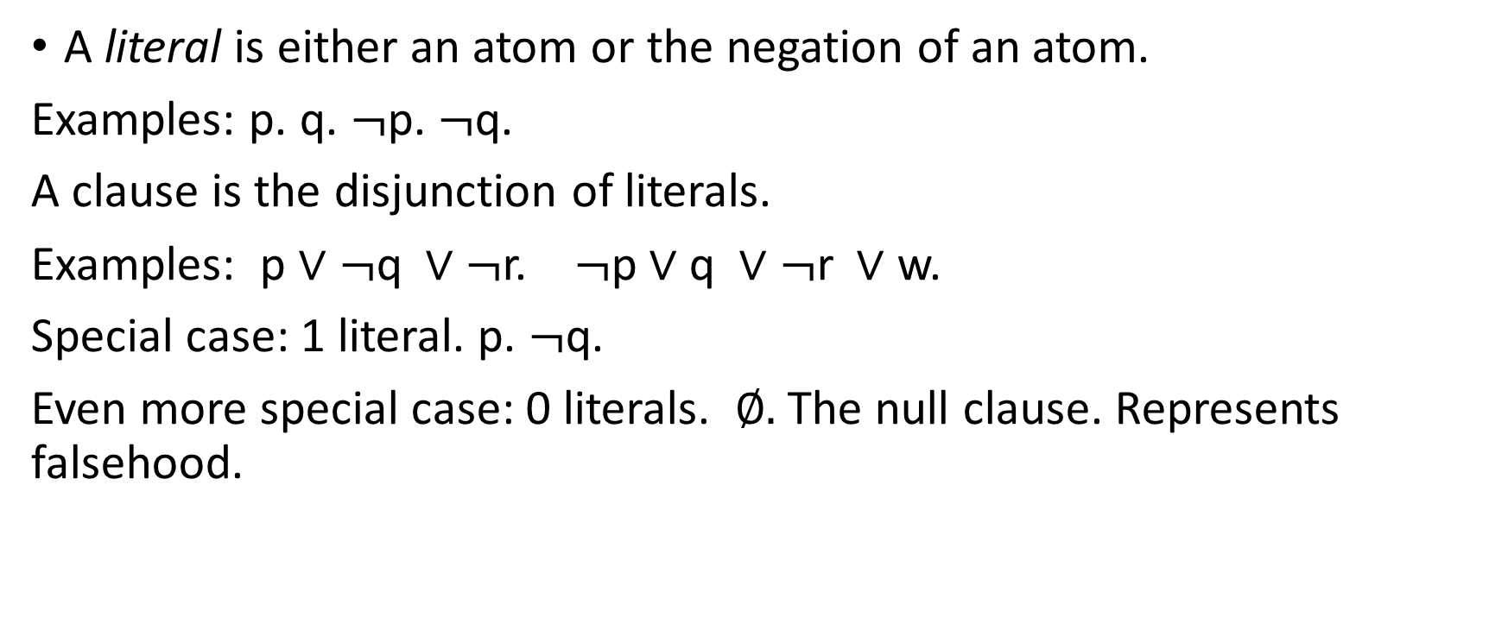
Conjunctive Normal Form (CNF)
A literal is either an atom or the negation of an atom.
Examples: p. q. $¬$p. $¬$q.
A clause is the disjunction of literals.
Examples: p ∨ $¬$q ∨ $¬$r. $¬$p ∨ q ∨ $¬$r ∨ w.
Special case: 1 literal. p. $¬$q.
Even more special case: 0 literals. ∅. The null clause. Represents falsehood.

Slide 15
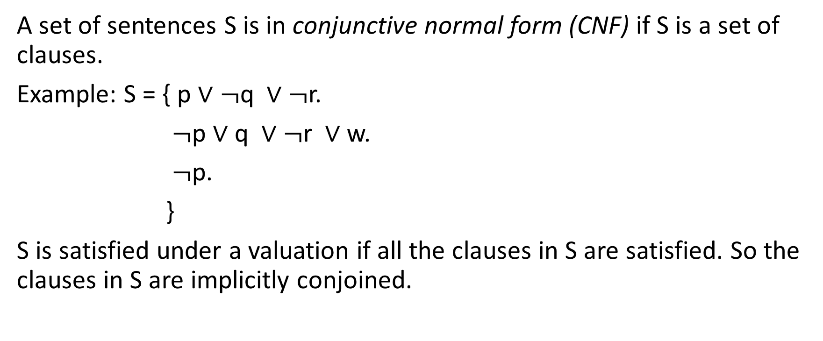
CNF continued
A set of sentences S is in conjunctive normal form (CNF) if S is a set of clauses.
Example: S = { p ∨ $¬$q ∨ $¬$r.
$¬$p ∨ q ∨ $¬$r ∨ w.
$¬$p.
}
S is satisfied under a valuation if all the clauses in S are satisfied. So the clauses in S are implicitly conjoined.

Slide 16
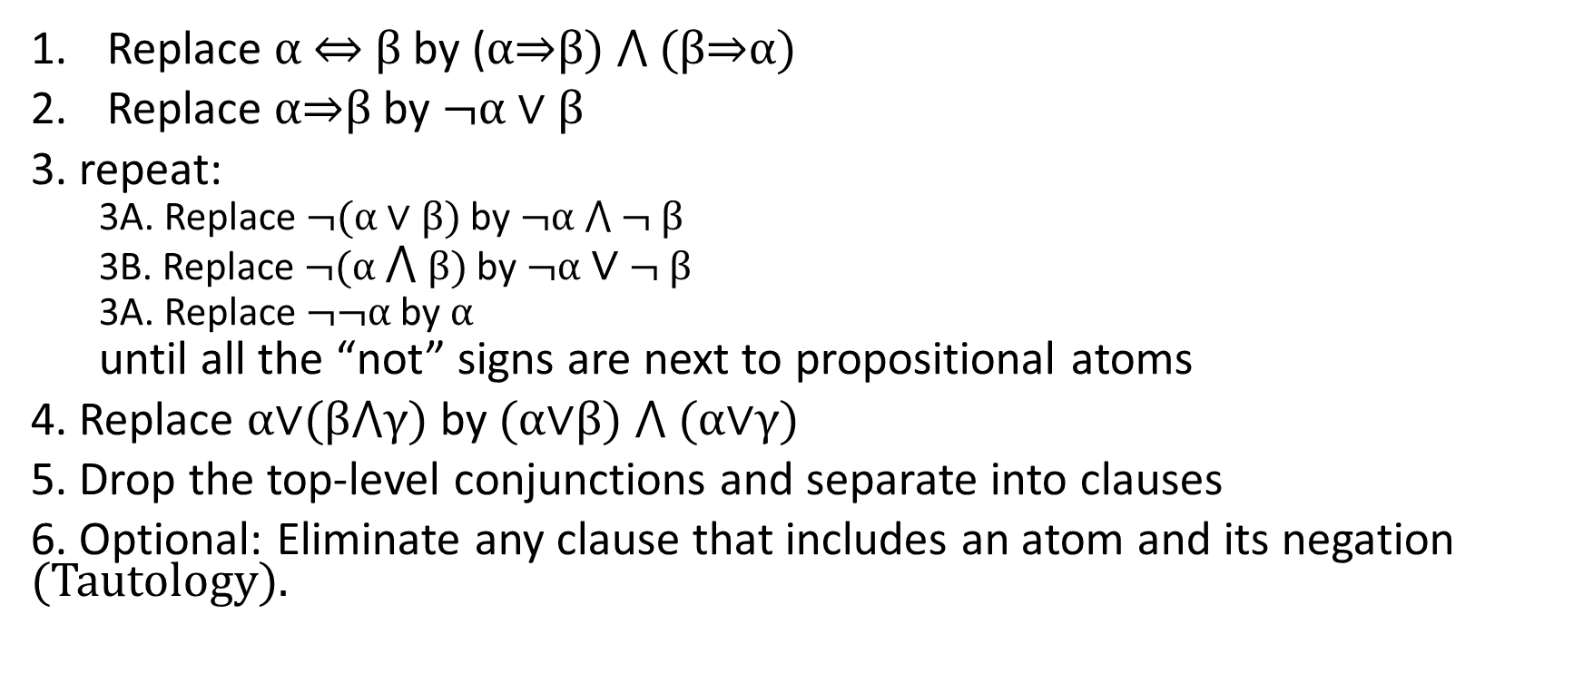
Converting a sentence to CNF
Replace α ⇔ β by (α⇒β) ⋀ (β⇒α)
Replace α⇒β by $¬$α ∨ β
3. repeat:
3A. Replace $¬$(α ∨ β) by $¬$α ⋀ $¬$ β
3B. Replace $¬$(α ⋀ β) by $¬$α ∨ $¬$ β
3A. Replace $¬¬$α by α
until all the “not” signs are next to propositional atoms
4. Replace α∨(β⋀γ) by (α∨β) ⋀ (α∨γ)
5. Drop the top-level conjunctions and separate into clauses
6. Optional: Eliminate any clause that includes an atom and its negation (Tautology).

Slide 17
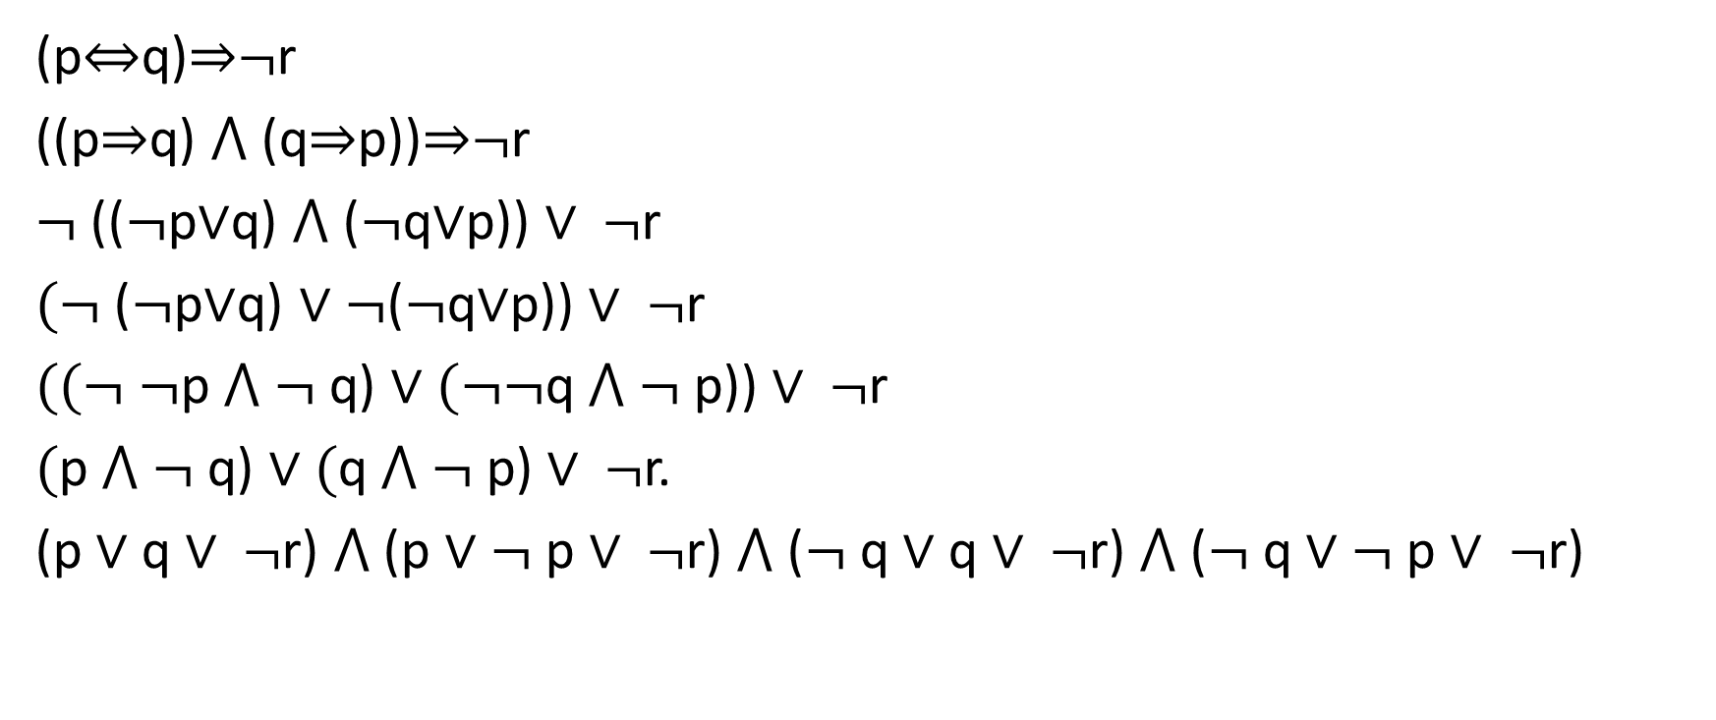
Example
(p⇔q)⇒$¬$r
((p⇒q) ⋀ (q⇒p))⇒$¬$r
$¬$(($¬$p∨q) ⋀ ($¬$q∨p)) ∨ $¬$r
$(¬$($¬$p∨q) ∨ $¬$($¬$q∨p)) ∨ $¬$r
$((¬ ¬$p ⋀ $¬$q) ∨ $(¬¬$q ⋀ $¬$p)) ∨ $¬$r
$($p ⋀ $¬$q) ∨ $($q ⋀ $¬$p) ∨ $¬$r.
(p ∨ q ∨ $¬$r) ⋀ (p ∨ $¬$p ∨ $¬$r) ⋀ ($¬$q ∨ q ∨ $¬$r) ⋀ ($¬$q ∨ $¬$p ∨ $¬$r)

Slide 18

Example
(p⇔q)⇒$¬$r
…
(p ∨ q ∨ $¬$r) ⋀ (p ∨ $¬$p ∨ $¬$r) ⋀ ($¬$q ∨ q ∨ $¬$r) ⋀ ($¬$q ∨ $¬$p ∨ $¬$r)
{p ∨ q ∨ $¬$r.
p ∨ $¬$p ∨ $¬$r. {p ∨ q ∨ $¬$r.
$¬$q ∨ q ∨ $¬$r. $¬$q ∨ $¬$p ∨ $¬$ r.
$¬$q ∨ $¬$p ∨ $¬$ r. }
}

Slide 19
General idea of DPLL
In a series of calls, you
Assign truth values to atoms.
Make the set of clauses simpler and simpler by deleting clauses and deleting literals from clauses.
When an atom is assigned a truth value:
Any clause where that atom appears with the same sign as the truth value is now satisfied. So the clause can now be deleted.
If a clause contains a literal of the atom with the opposite sign, then that is no longer a way of satisfying the clause. So that literal can be deleted.
The recursion comes to an end when either:
All the clauses have been deleted because they are satisfied. Success!
In some clause, all the literals have been deleted. That clause can no longer be satisfied. Failure. Backtrack.

Slide 20
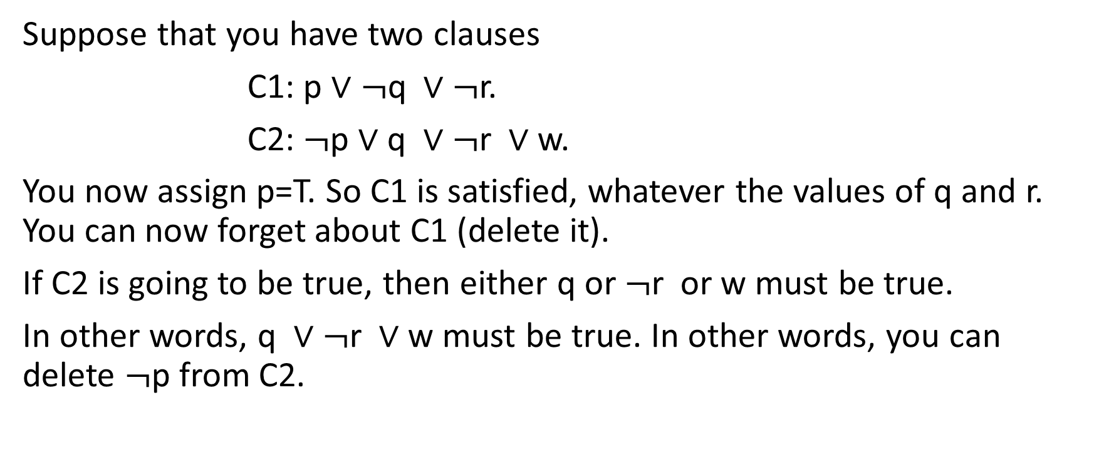
Example
Suppose that you have two clauses
C1: p ∨ $¬$q ∨ $¬$r.
C2: $¬$p ∨ q ∨ $¬$r ∨ w.
You now assign p=T. So C1 is satisfied, whatever the values of q and r. You can now forget about C1 (delete it).
If C2 is going to be true, then either q or $¬$r or w must be true.
In other words, q ∨ $¬$r ∨ w must be true. In other words, you can delete $¬$p from C2.

Slide 21
DPLL algorithm: High-level pseudo-code
dpll(CS,B) { % CS==set of clauses. B=Bindings of atoms to truth values
loop() {
if (empty(CS)) return B;
if (emptyClause in CS) return Fail;
if (easyCaseIn(CS,B)) [CS,B] = easyCase(CS,B); //add pure literal case
} % No easy cases
CSCopy = copy(CS); BCopy=Copy(B);
P = choose an unbound atom; //choose min of abs.values
[CSCopy, BCopy] = propagate(CSCopy, BCopy, P, True);
answer = dpll(CSCopy,BCopy);
if (answer != Fail) return answer;
[CS, B] = propagate(CS, B, P, False);
return dpll(CS,B)
}

Slide 22
Propagate
propagate(CS, B, A, V) { % CS: set of clauses; B: bindings; A: atom
B = add <A,V> to B; % V: truth value
for (each clause C in CS) {
if (A appears in C with sign V) delete C from CS;
if (A appears in C with sign !V) delete that literal from C;
}
return (CS,B);
}

Slide 23
Easy cases
Case 1: Singleton clause.
if (there is a clause in CS with only one literal L)
return propagate(CS,B, atomOf(L), valueOf(L));
Case 2: Pure literal
if (there is an atom A that appears in CS with only one sign V)
return propagate(CS, B, A, V);

Slide 24
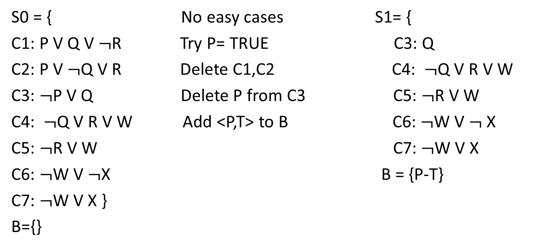
Example
S0 = { No easy cases S1= {
C1: P V Q V $¬$R Try P= TRUE C3: Q
C2: P V $¬$Q V R Delete C1,C2 C4: $¬$Q V R V W
C3: $¬$P V Q Delete P from C3 C5: $¬$R V W
C4: $¬$Q V R V W Add <P,T> to B C6: $¬$W V $¬$X
C5: $¬$R V W C7: $¬$W V X
C6: $¬$W V $¬$X B = {P-T}
C7: $¬$W V X }
B={}

Slide 25
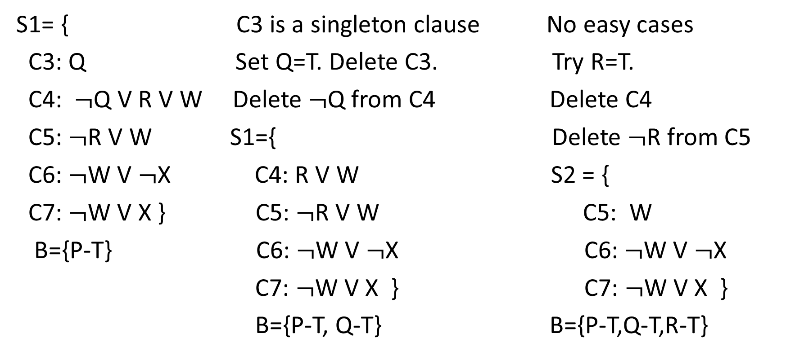
Example (slide 2)
S1= { C3 is a singleton clause No easy cases
C3: Q Set Q=T. Delete C3. Try R=T.
C4: $¬$Q V R V W Delete $¬$Q from C4 Delete C4
C5: $¬$R V W S1={ Delete $¬$R from C5
C6: $¬$W V $¬$X C4: R V W S2 = {
C7: $¬$W V X } C5: $¬$R V W C5: W
B={P-T} C6: $¬$W V $¬$X C6: $¬$W V $¬$X
C7: $¬$W V X } C7: $¬$W V X }
B={P-T, Q-T} B={P-T,Q-T,R-T}

Slide 26
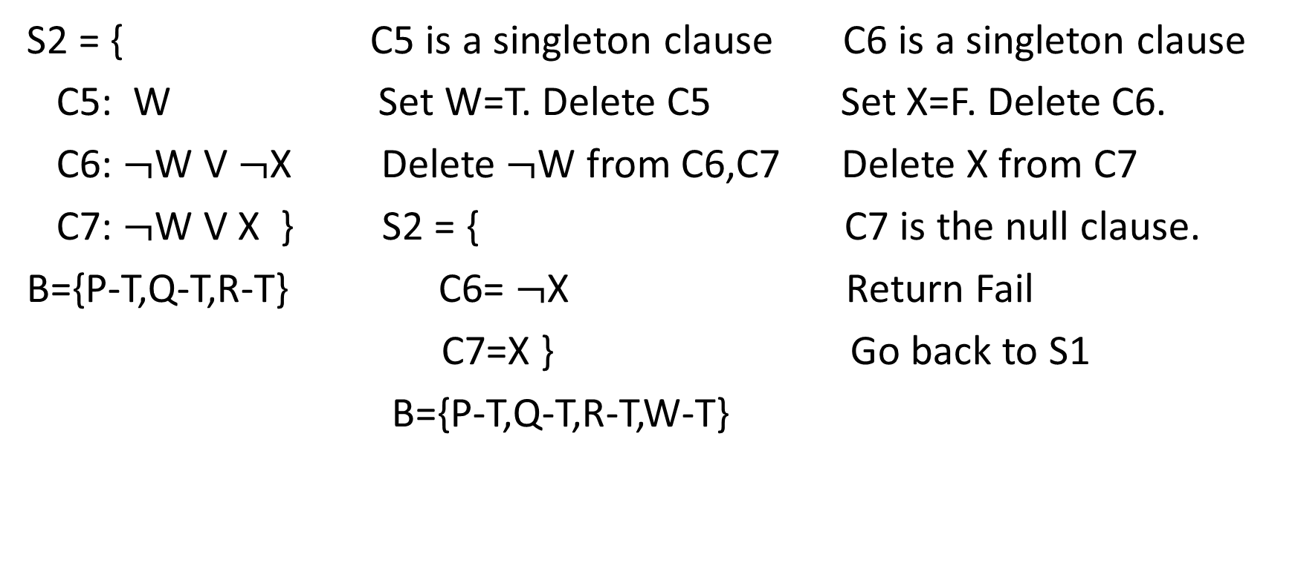
Example (slide 3)
S2 = { C5 is a singleton clause C6 is a singleton clause
C5: W Set W=T. Delete C5 Set X=F. Delete C6.
C6: $¬$W V $¬$X Delete $¬$W from C6,C7 Delete X from C7
C7: $¬$W V X } S2 = { C7 is the null clause.
B={P-T,Q-T,R-T} C6= $¬$X Return Fail
C7=X } Go back to S1
B={P-T,Q-T,R-T,W-T}

Slide 27
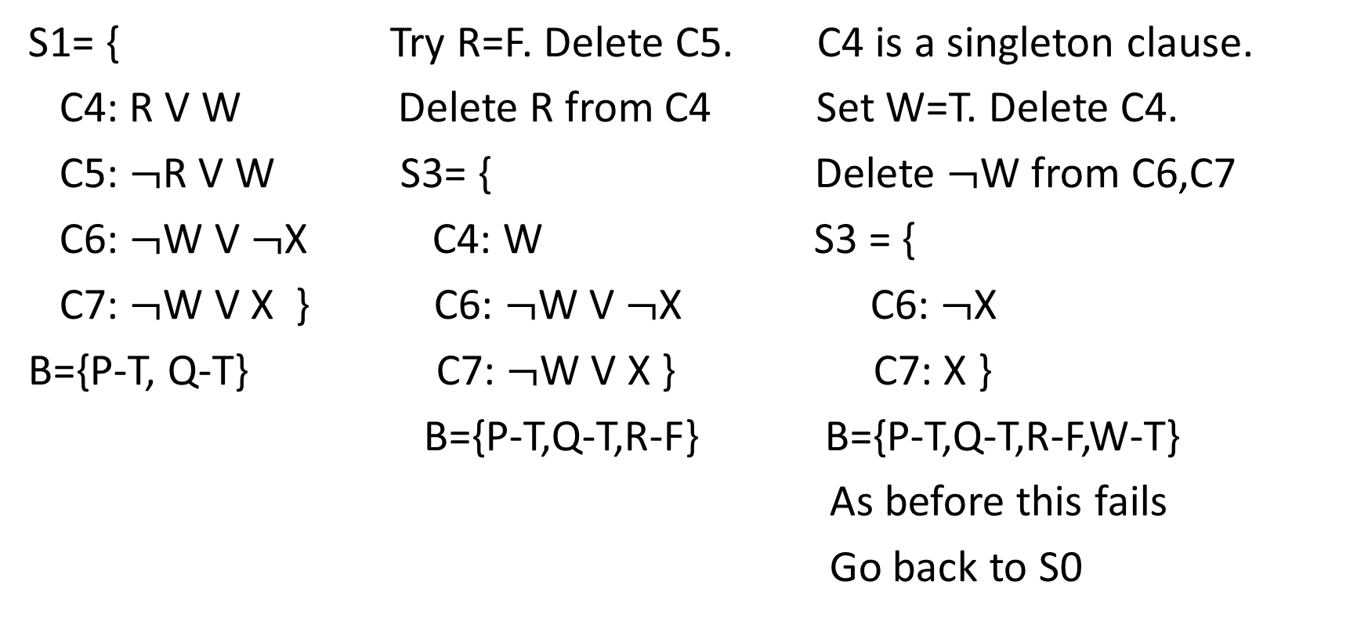
Example (slide 4)
S1= { Try R=F. Delete C5. C4 is a singleton clause.
C4: R V W Delete R from C4 Set W=T. Delete C4.
C5: $¬$R V W S3= { Delete $¬$W from C6,C7
C6: $¬$W V $¬$X C4: W S3 = {
C7: $¬$W V X } C6: $¬$W V $¬$X C6: $¬$X
B={P-T, Q-T} C7: $¬$W V X } C7: X }
B={P-T,Q-T,R-F} B={P-T,Q-T,R-F,W-T}
As before this fails
Go back to S0

Slide 28
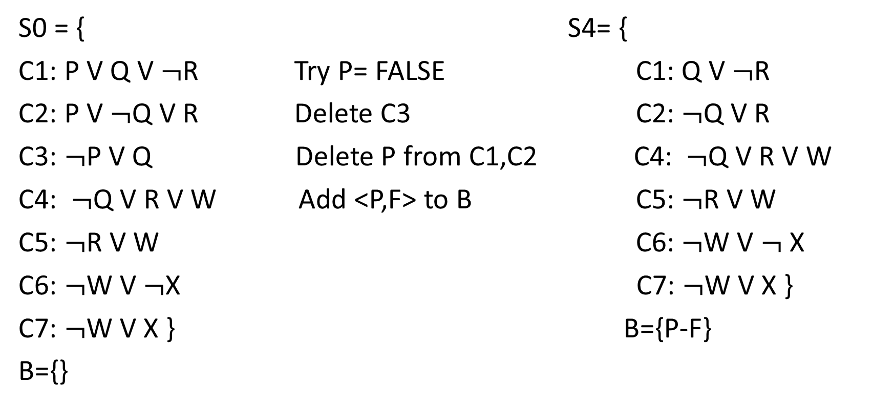
Example: Slide 5
S0 = { S4= {
C1: P V Q V $¬$R Try P= FALSE C1: Q V $¬$R
C2: P V $¬$Q V R Delete C3 C2: $¬$Q V R
C3: $¬$P V Q Delete P from C1,C2 C4: $¬$Q V R V W
C4: $¬$Q V R V W Add <P,F> to B C5: $¬$R V W
C5: $¬$R V W C6: $¬$W V $¬$X
C6: $¬$W V $¬$X C7: $¬$W V X }
C7: $¬$W V X } B={P-F}
B={}

Slide 29
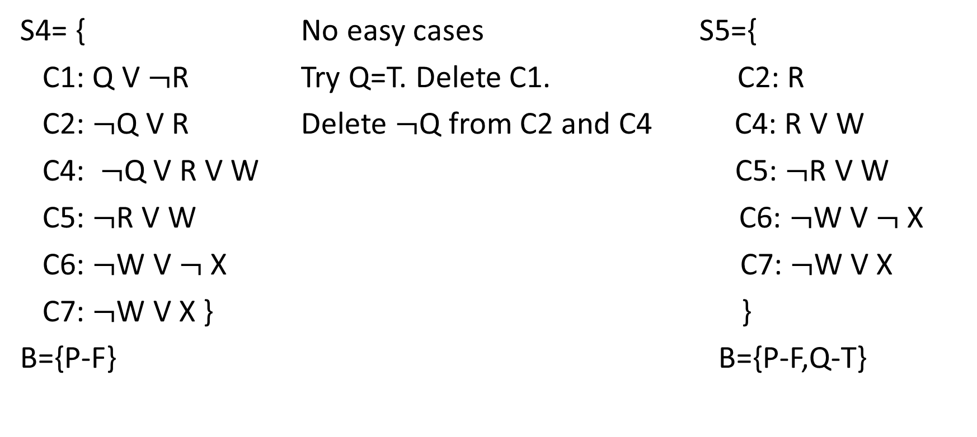
Example: Slide 6
S4= { No easy cases S5={
C1: Q V $¬$R Try Q=T. Delete C1. C2: R
C2: $¬$Q V R Delete $¬$Q from C2 and C4 C4: R V W
C4: $¬$Q V R V W C5: $¬$R V W
C5: $¬$R V W C6: $¬$W V $¬$X
C6: $¬$W V $¬$X C7: $¬$W V X
C7: $¬$W V X } }
B={P-F} B={P-F,Q-T}

Slide 30
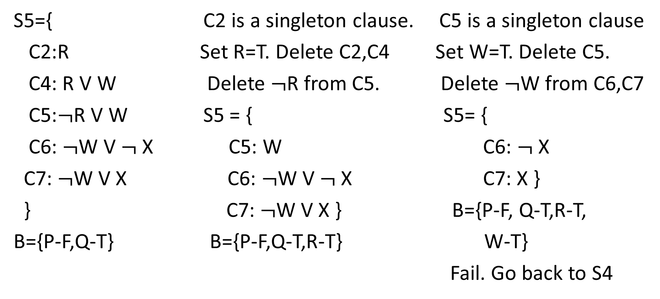
Example: Slide 7
S5={ C2 is a singleton clause. C5 is a singleton clause
C2:R Set R=T. Delete C2,C4 Set W=T. Delete C5.
C4: R V W Delete $¬$R from C5. Delete $¬$W from C6,C7
C5:$¬$R V W S5 = { S5= {
C6: $¬$W V $¬$X C5: W C6: $¬$X
C7: $¬$W V X C6: $¬$W V $¬$X C7: X }
} C7: $¬$W V X } B={P-F, Q-T,R-T,
B={P-F,Q-T} B={P-F,Q-T,R-T} W-T}
Fail. Go back to S4

Slide 31
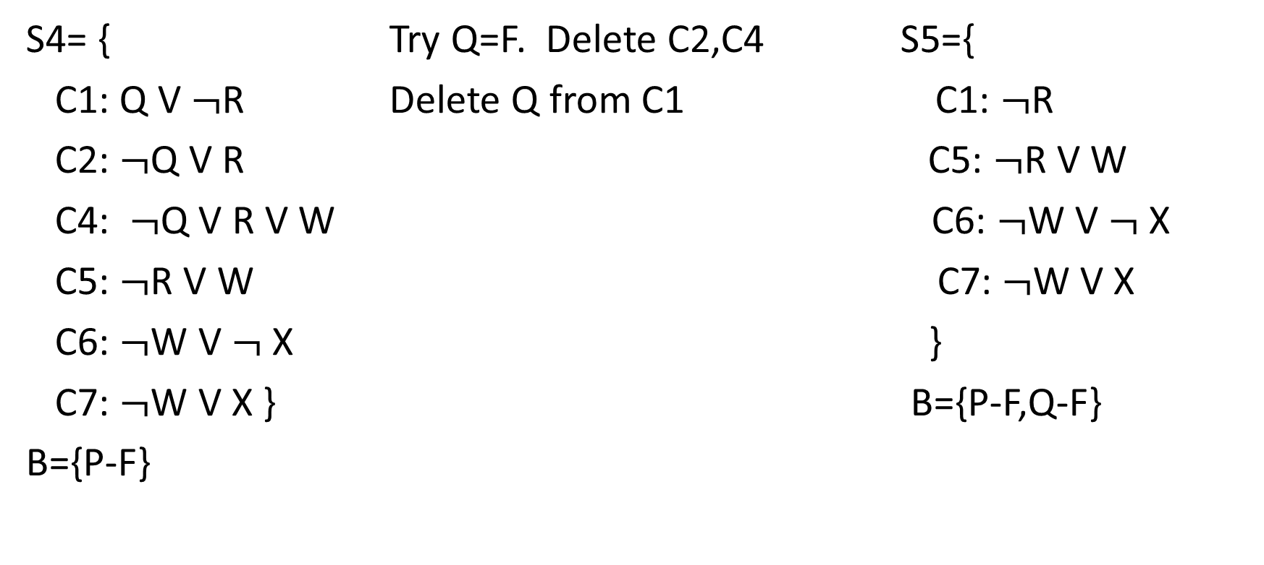
Example: Slide 8
S4= { Try Q=F. Delete C2,C4 S5={
C1: Q V $¬$R Delete Q from C1 C1: $¬$R
C2: $¬$Q V R C5: $¬$R V W
C4: $¬$Q V R V W C6: $¬$W V $¬$X
C5: $¬$R V W C7: $¬$W V X
C6: $¬$W V $¬$X }
C7: $¬$W V X } B={P-F,Q-F}
B={P-F}

Slide 32
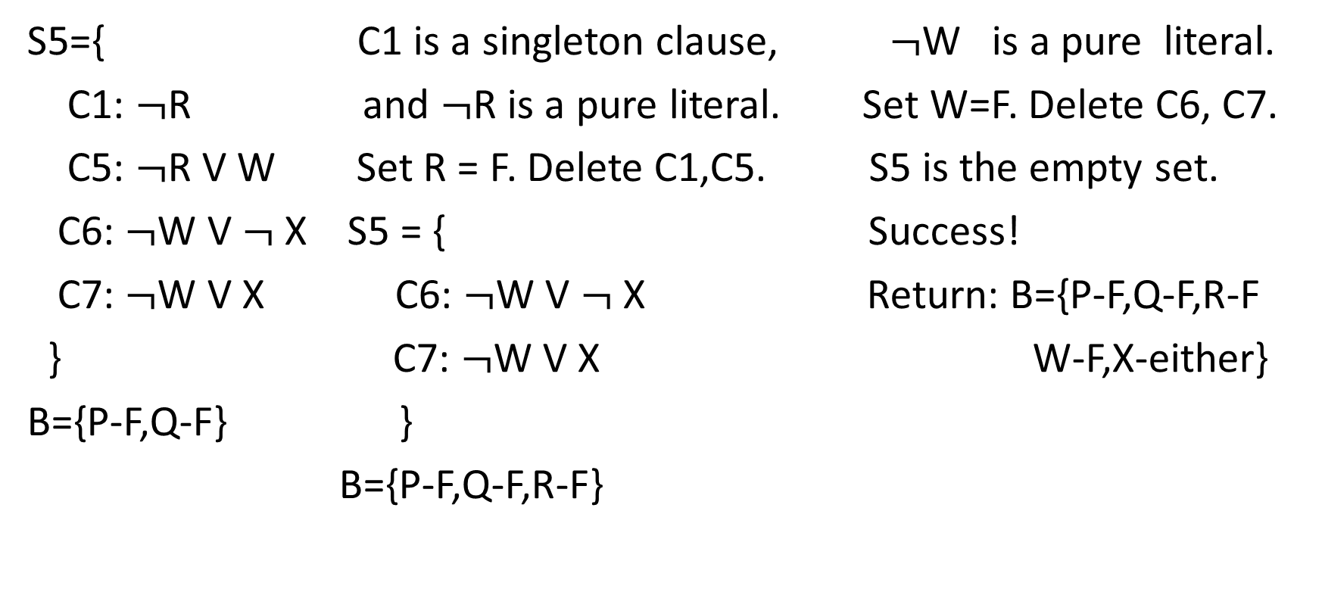
Example: Slide 9
S5={ C1 is a singleton clause, $¬$W is a pure literal.
C1: $¬$R and $¬$R is a pure literal. Set W=F. Delete C6, C7.
C5: $¬$R V W Set R = F. Delete C1,C5. S5 is the empty set.
C6: $¬$W V $¬$X S5 = { Success!
C7: $¬$W V X C6: $¬$W V $¬$X Return: B={P-F,Q-F,R-F
} C7: $¬$W V X W-F,X-either}
B={P-F,Q-F} }
B={P-F,Q-F,R-F}

Slide 33

Check your answer!
S0 = {
C1: P V Q V $¬$R
C2: P V $¬$Q V R
C3: $¬$P V Q
C4: $¬$Q V R V W
C5: $¬$R V W
C6: $¬$W V $¬$X
C7: $¬$W V X }
B={P-F, Q-F, R-F, W-F, X-either}

